Slide 1
GLOBAL LOGISTICS MANAGEMENT

Slide 2
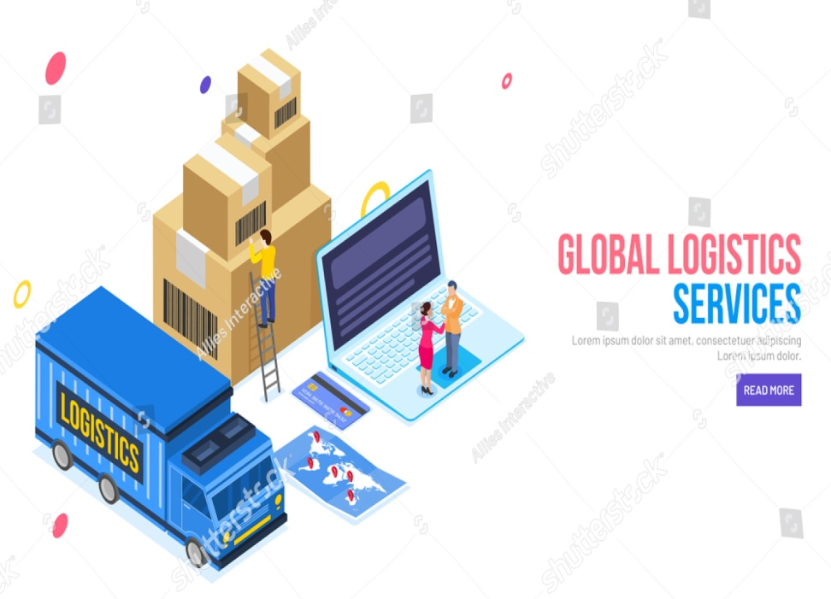
Title and presentation outline
The overall presentation is based on the Wal-Mart company and the global logistics services of the company.
Global logistics services are nowadays one of the major concerns of every company that is able to smooth the supply chain management (Mikl et al., 2020).
It also includes the different types of firms' value for creative activities and the role of the form in the marketing channel.
Notes:
In this way, the overall slide is used to talk about the structure of the presentation and also provide the different knowledge about what would be getting discussed in the next slides. It also elaborates on the circular economy and industry 4.0 alignment with the Logistic operations of the company.

Slide 3
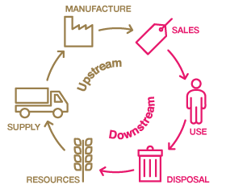
Upstream and downstream logistics channels and operational strategies
The Walmart company always tries to use the different levels of Strategies for maintaining the upstream and downstream logistics channels.
The company has different upstream suppliers who always try to coordinate the different related operations (Shu, 2022).
On the other hand, the Walmart company has multiple upstream manufacturers with different areas of the downstream single retailer.
Notes:
In that way, it has been found that the Walmart company uses the maximum number of retailers in the upstream channel for the Logistic services and was handling the different operations. on the other hand, there's no focus on the downstream register panel so use only a single retailer on that.

Slide 4
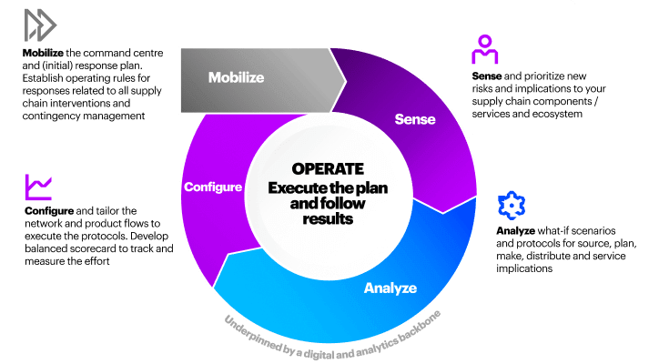
Disruption mitigation strategies and management
Walmart company highlights their mitigating backup by Global shipping and increment in the supply network.
Walmart companies have a high level of Technology infrastructure that can increase the network design accurately (Woong and Goh, 2021).
In that way, they can accurately forecast the overall demand of the customer.
Notes:
In this way, it has been found that the former company has proper destruction and mitigation Strategies and also management strategies that can easily manage the supply chain management system within the organisation.

Slide 5

Key lessons learnt from the pandemic
At the time of the pandemic situation, Wal-Mart was not able to properly do the marketing on the offline platform.
Independent situation the Wal-Mart company cannot help the community to live better.
Wal-Mart has to provide paid media at the time of the health crisis (Yuan, Zhang and Wong, 2021).
Notes:
In that way, it has been found that the lesson they learn from the pen debate is that they have to be properly careful and concerned about the uncertain rest and also the different strategies that decrease marketing problems.

Slide 6
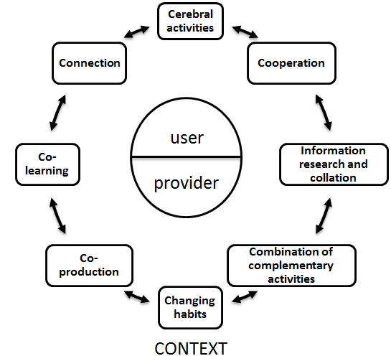
Value co-creation activities
Walmart companies always encourage their stakeholders as well as shareholders to provide value creation.
On the other hand, they are trying to fulfil the overall requirements of the consumers (Sheth, 2019).
At the time of pandemics, they also used home deli activities to make comfort for consumers.
Notes:
In that way, it has been found that the Walmart company always tries to provide the proper planning to the consumers and the stakeholders of the company.

Slide 7

Achieving marketing channel network goals using appropriate technologies
Walmart uses the only channel strategy that they can attract consumers.
It uses that type of technology that is simple to manage and easy to access.
On the other hand, the Walmart company also uses a different slogan which is used to engage the consumers in the marketing channel (Jin et al., 2018).
Notes:
In this way by the use of different technologies as well as strategies the company can easily fulfil the goal of the marketing channel network.

Slide 8
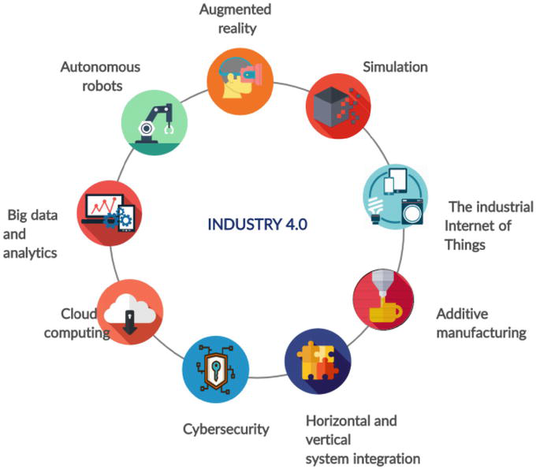
Circular economy and Industry 4.0 alignment
Walmart also uses the industry 4.0 technology to increase the marketing channel network.
It provides the proper automation techniques by which they can manufacture Technology (Ćwiklicki and Wojnarowska, 2020).
On the other hand, the use of a circular economy model involves the proper sharing and reusing the waste materials.
Notes:
In that way, it has been found that the Walmart company created so much achievement in the marketing-generated work goals by the use of industry 4.0 and circular economy. Which type of technologies are helpful to provide the proper operational management and increment in the economic system of the company.

Slide 9
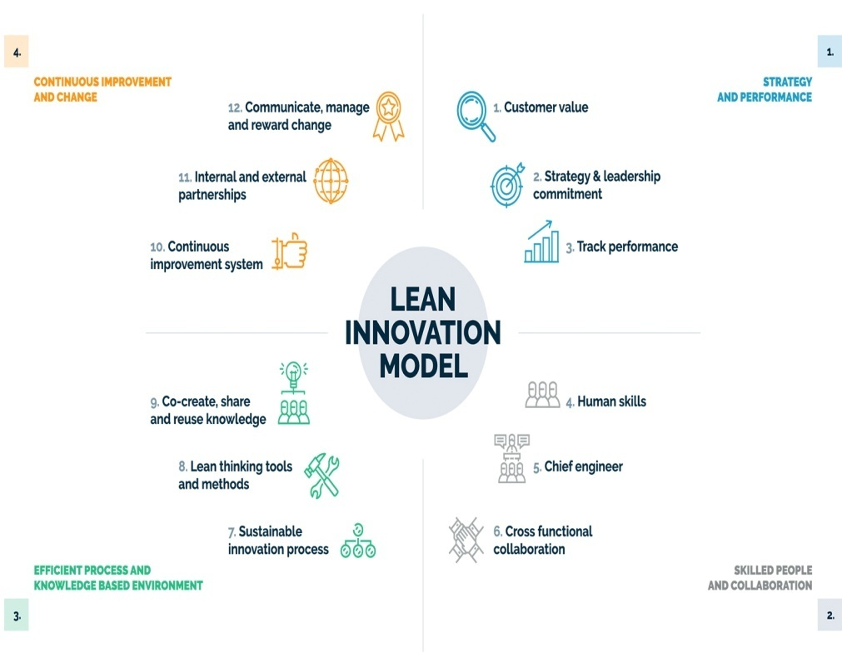
Innovation-led lean approaches and recommendations on sustainability
To increase sustainability within the company can use an Innovation-led lean approach (Bhattacharya and Dey, 2020).
by the use of this approach, the company can potentially make a positive contribution to the average dimensions of the supply chain management.
The Walmart company tried to increase the use of renewable energy sources that can include sustainability.
Notes:
In this way by the use of Innovation-led lean methods and renewable energy sources they can increase the sustainability of the company within the market. Through the renewable energy sources and the innovation method, the company can be able to increase the different management techniques of the operations of the company and provide a smooth supply chain within the organisation.

Slide 10

Personal reflections
After the overall research on Walmart company and its logistics services, I found that the Walmart company has to be strategic to maintain the supply chain management system.
The company already has a different type of technology but they need to be more updated according to the situation.
In the pandemic situation, the company has to face different types of problem areas in the marketing channels and networks.
Therefore it creates a lot of problems for the organisation to properly manage the Marketing System (Patro et al., 2020).
Notes:
In that way, I found that the company has to be more strategic about the marketing channel and the networking issues. The company also faced different types of marketing issues in the pendant situation. Therefore, they need to be more concerned about the uncertain risk and also find out the different alternate ways that can be used in the uncertain.

Slide 11
Reference List
Bhattacharya, A. and Dey, P.K., (2020). Achieving sustainability through innovation-led lean approaches to manufacturing supply chains. International Journal of Production Economics, 219, pp.402-404.https://ueaeprints.uea.ac.uk/id/eprint/72998/1/Accepted_Manuscript.pdf
Ćwiklicki, M. and Wojnarowska, M., (2020). Circular economy and industry 4.0: One-way or two-way relationships?. Engineering Economics, 31(4), pp.387-397.https://www.inzeko.ktu.lt/index.php/EE/article/view/24565/14511
Jin, H., Wang, H., Park, S.T. and Kim, Y.K., (2018). Research on Marketing Strategy of Traditional Retailers under the Background of Internet-A Case Study of Wal-Mart. INTERNATIONAL JOURNAL OF EMERGING MULTIDISCIPLINARY RESEARCH (IJEMR), 2(3), pp.27-32.http://ijemr.ascons.org/journals/ijemr/digital-library/manuscript/file/15409/2(3)_4.pdf
Mikl, J., Herold, D.M., Pilch, K., Ćwiklicki, M. and Kummer, S., (2020). Understanding disruptive technology transitions in the global logistics industry: the role of ecosystems. Review of International Business and Strategy.https://www.emerald.com/insight/content/doi/10.1108/RIBS-07-2020-0078/full/pdf
Patro, G.K., Chakraborty, A., Banerjee, A. and Ganguly, N., (2020), September. Towards safety and sustainability: Designing local recommendations for post-pandemic world. In Fourteenth ACM Conference on Recommender Systems (pp. 358-367).https://mail.easychair.org/publications/preprint_download/npxr
Sheth, J.N., (2019). Customer value propositions: Value co-creation. Industrial Marketing Management, 87, pp.312-315.https://www.researchgate.net/profile/Jagdish-Sheth/publication/337437112_Customer_value_propositions_Value_co-creation/links/5dd97e20458515dc2f48ca0c/Customer-value-propositions-Value-co-creation.pdf
Shu, J., (2022), March. The Business Model of Multinational Retail Companies under the New Retail Environment in China. In 2022 7th International Conference on Financial Innovation and Economic Development (ICFIED 2022) (pp. 779-783). Atlantis Press.https://www.atlantis-press.com/article/125971504.pdf
Woong, J.Y. and Goh, S.H., (2021). Supply chain risk management strategies in the face of COVID-19. In Conference on Industrial Engineering and Operations Management Singapore (pp. 7-11).https://www.researchgate.net/profile/Shao-Hung-Goh/publication/347909700_Supply_Chain_Risk_Management_Strategies_in_the_Face_of_COVID-19/links/5fe6d283a6fdccdcb800b0c7/Supply-Chain-Risk-Management-Strategies-in-the-Face-of-COVID-19.pdf
Yuan, M., Zhang, N. and Wong, Z.G., (2021), December. Walmart China Face the Marketing Strategic Issues and What’s their Future Plan. In 2021 3rd International Conference on Economic Management and Cultural Industry (ICEMCI 2021) (pp. 2922-2926). Atlantis Press.https://www.atlantis-press.com/article/125966288.pdf

